Slide 1
Flutter and Firebase - like peanut butter and chocolate
Don Ward
Quicken Loans
Senior Research Engineer
donward@quickenloans.com

Slide 2


Who am I?
Led Quicken Loans Mobile Team for a few years
Recently finished 100 Days of Code on Flutter
Founder and Co-Lead GDG Detroit for 7 years
Founder and Leader of GDG Windsor ~ 1 year

Slide 3

Quicken Loans
TECHNOLOGY

Slide 4
Notes:
QL Culture

Slide 5
What will you learn?
The current state of Flutter
A rundown of Firebase services available to Flutter apps

Slide 6
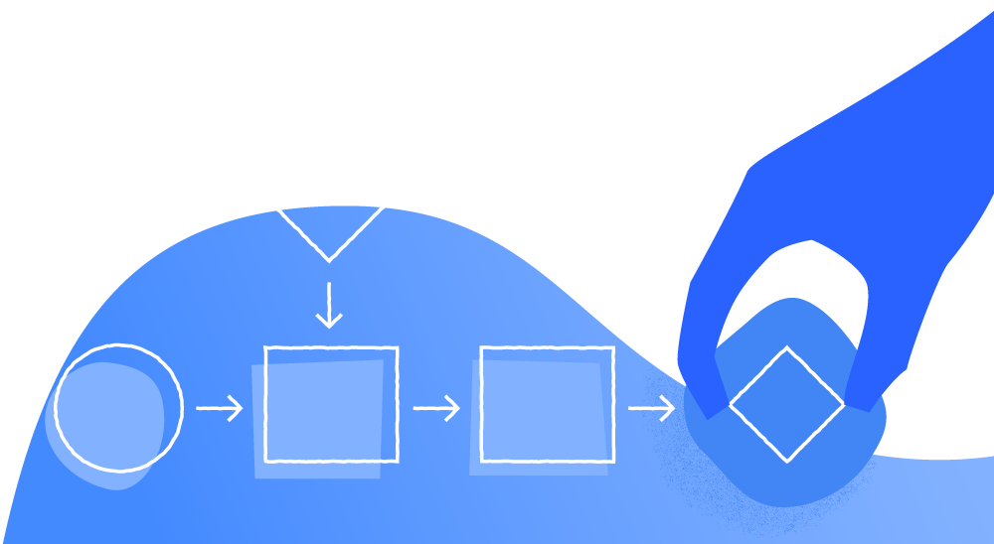
A Quick Intro to Flutter and What’s New

Slide 7
Flutter in a Nutshell
Declarative UI
Cross Platform – iOS/Android/Web and ChromeOS
Developed in Dart
Started in 2016 – Flutter 1.0 in Dec 2018

Slide 8
Why Flutter?
Fast development and rapid prototyping
Hot Stateful Reload and Restart
Quick ramp up
Support across IDE’s
Lot’s of Firebase support
Not just mobile now!

Slide 9
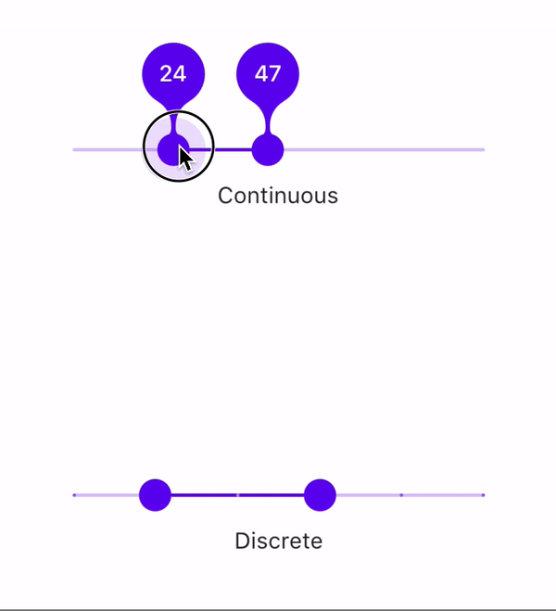
What’s new in Flutter?
Dec 2018 – Flutter 1.0
May 2019 – Flutter 1.5
July 2019 – Flutter 1.7
Android X Support
Android App Bundles
RangeSlider Widget

Slide 10
In Flutter – everything is a Widget

Slide 11
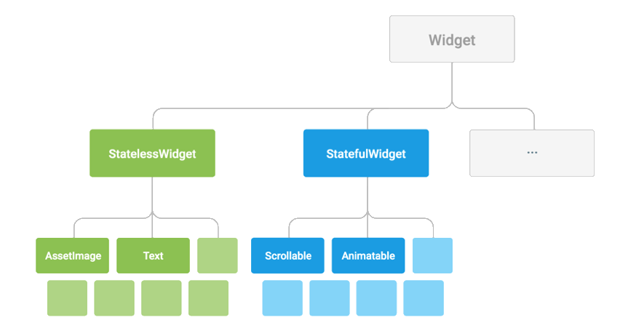

Slide 12
Cross Platform by using a Layered Approach

Slide 13
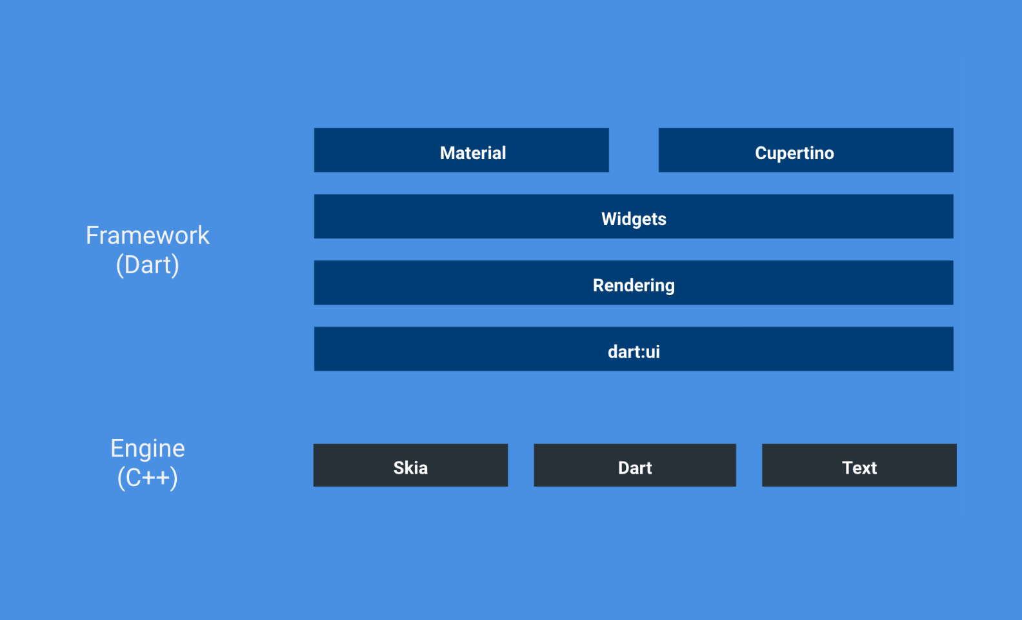

Slide 14

A Quick Intro to Firebase

Slide 15
Firebase in a Nutshell
A set of backend services for mobile apps
Founded 2011
Acquired by Google 2014
18 Products - 1.5 million apps

Slide 16
Why Firebase?
Mobile Devs are not backend engineers
Quick setup and development
Global scale
Best in class services (Crashlytics)
Android/iOS and Web support

Slide 17
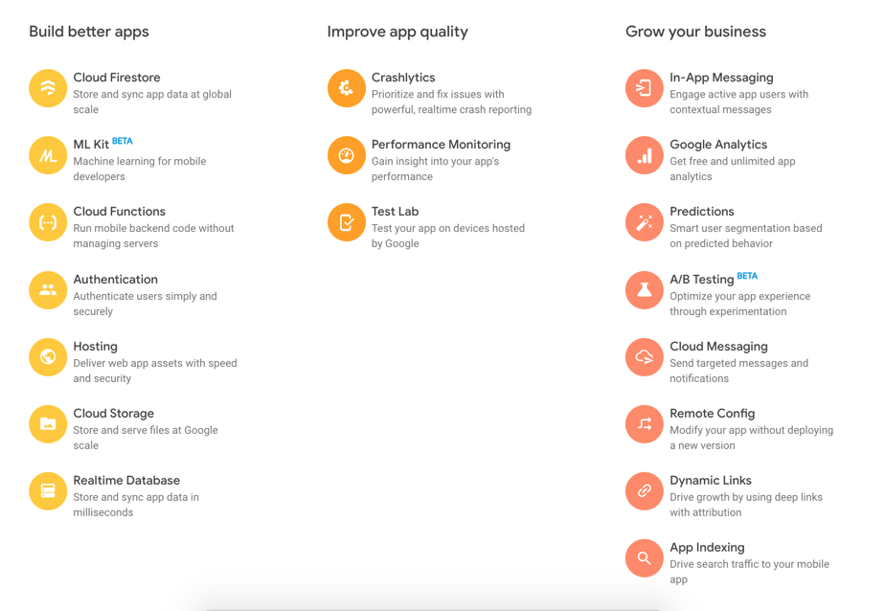

Slide 18
Great!
How much is this going to cost me?
https://firebase.google.com/pricing

Slide 19

Let’s talk about FlutterFire

Slide 20
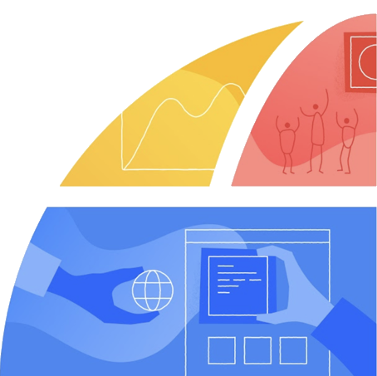
What is FlutterFire?
Flutter Plugins for Firebase
How to install a Flutter Plugin
https://github.com/flutter/plugins/blob/master/FlutterFire.md

Slide 21

‘Why FlutterFire?’

Slide 22
Our First Firebase Service – Firebase Auth

Slide 23
What is Firebase Auth?
Provides end to end identity solution for
Google
Twitter
Facebook
Github
Email
SMS

Slide 24
What I learned
Flutter plugins needed:
firebase_auth
flutter_auth_buttons
Google_sign_in
Facebook proved too difficult for me

Slide 25
Additional Learnings
Sample Code from the Github repo
https://github.com/flutter/plugins/tree/master/packages/firebase_auth
Can be tied to auth for all of the other services

Slide 26
Firebase Cloud Firestore

Slide 27
What is Firebase Cloud Firestore?
Firebase’s latest database solution
NoSQL dB
Not the original dB solution - Realtime dB
Provides Storage across Regions in GCP
Near real-time
Built into GCP - allows use of Cloud Functions

Slide 28
How does it work?
Collections -> Document -> key-value pairs

Slide 29
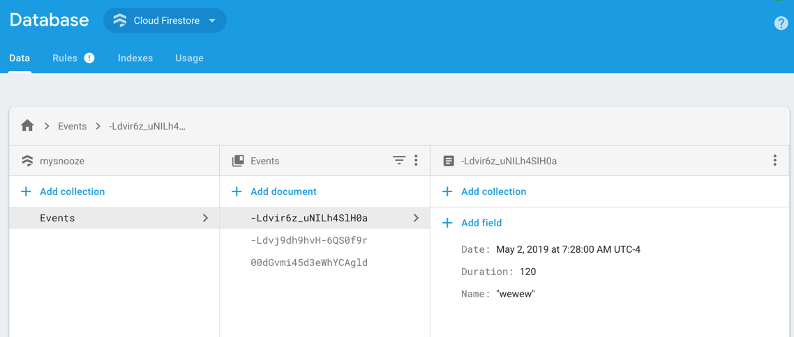

Slide 30
What I learned
Flutter plugins needed:
cloud_firestore
Use transactions when writing
Flutter has a number of Reactive Widgets to support the async nature of data

Slide 31
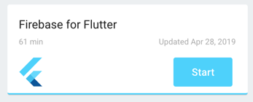
Lastly
Google has a good code lab on hooking up a Flutter App to Cloud Firestore

Slide 32
Firebase MLKit

Slide 33
What is Firebase MLKit?
The coolest Firebase service!
Hosted Machine Learning Models to be deployed to your app from Firebase
MLKit takes care of keeping them up to date

Slide 34
What ML Models are available in MLKit?

Slide 35
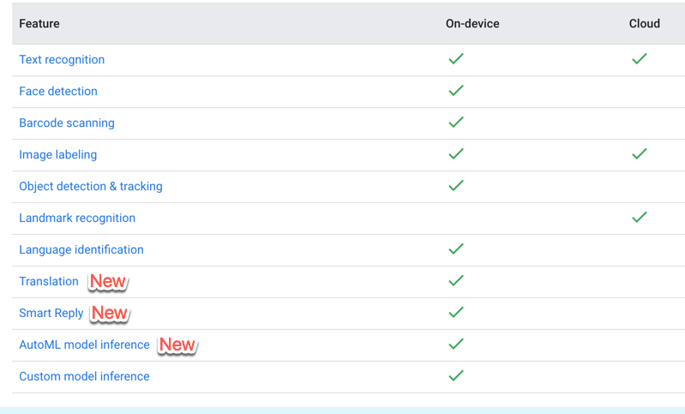

Slide 36
One downside with Flutter and MLKit

Slide 37
Not all of the Models are
supported – yet.
Supported models:
Barcode Detection
Face Detection
Label Detection
Text Detection

Slide 38
Cloud Messaging

Slide 39
What is Firebase Cloud Messaging?
Push notifications – super well designed!
What I learned -> super simple to setup
Add the plugin -> Firebase_messaging
Listen in your app for messages

Slide 40
Firebase Remote Config

Slide 41
What is Firebase Remote Config?
Remotely config your app based on key-value pairs stored in Firebase.
Allows configuration with a new release
Uses -> Theming & A/B Testing

Slide 42
Simple to use – made for non-devs
Setup key-value pairs in Firebase Console
Remember to Publish them!

Slide 43
More Mobile Specific Services

Slide 44
Additional Services
Cloud Storage
Crashlytics
Performance Monitoring
Test Lab
App Indexing
Dynamic Links
Cloud Functions (non mobile)
Notes:
Cloud Storage - For storing static images and other assets - it is fairly easy to use this in conjunction with Cloud Firestore
Crashlytics - Google bought this in 2017 from Twitter and it is one of the best crash analytics tools out there
Performance Monitoring - real time performance monitoring - not much additional info I have
Test Lab - test your app on real devices
App Indexing - add your app to search results in Google Assistant
Dynamic Links - create links that deep-link and survive the Store Installation process
Cloud Functions - not mobile - think AWS Lambda - need an upgraded plan to call external services

Slide 45
What did we learn?
The current state of Flutter
A rundown of Firebase services available to Flutter apps

Slide 46

Thank you!
Don Ward
Quicken Loans
Senior Research Engineer
donward@quickenloans.com

